Slide 1




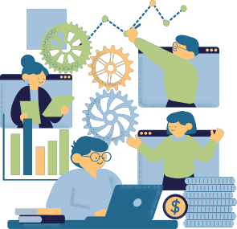



MLOPS
TechKalvi Talks

Slide 2


PART 2
BUILDING MLOPS PIPELINES AND AUTOMATION

Slide 3
INTRODUCTION
Definition: An MLOps pipeline automates each step of the ML workflow—from data preparation and model training to deployment and monitoring.
Purpose: Pipelines enable continuous integration and delivery (CI/CD) in ML, making model updates, re-training, and deployment faster and more reliable.
Goal: To ensure models adapt effectively to changing data while minimizing downtime.

Slide 4
STAGES IN PIPELINE
Data Ingestion and Preprocessing: Automates data collection, cleaning, transformation, and storage. Ensures the data used is consistent and of high quality, avoiding biases or data drift.
Model Training and Tuning: Involves training models with hyperparameter tuning and tracking experiment results. Ensures that the best-performing models are selected for production.
Model Validation: Evaluates models against performance metrics, ensuring they meet quality standards. Includes testing for issues like data leakage, overfitting, and robustness.
Model Deployment: Deploys the model in the production environment for real-time predictions or batch processing. Configures deployment infrastructure for scaling and performance.
Monitoring and Retraining: Continuously tracks model performance, data drift, and infrastructure health. Automatically triggers retraining if performance drops, ensuring models stay relevant.

Slide 5

AUTOMATION IN MLOPS PIPELINES
Why Automate? Automation reduces human error, speeds up model delivery, and allows rapid adaptation to new data.
Key Automations:
Data Pipeline Automation: Ensures fresh data is ingested and processed automatically.
Model Training and Testing: Scheduled model retraining and automated A/B testing to validate performance.
Deployment Automation: CI/CD pipelines deploy updated models seamlessly.
Monitoring Automation: Alerts and logs track model performance and system health.

Slide 6
TOOLS IN MLOPS
MLflow: A flexible tool for experiment tracking, model packaging, and deployment. MLflow is open-source and widely used for managing different versions of a model in development.
Kubeflow: Built specifically for Kubernetes, it helps teams deploy ML pipelines at scale. Kubeflow’s pipelines automate workflows, while Kubernetes manages scaling and resource allocation for large-scale deployments.
TensorFlow Extended (TFX): A production-ready ML platform from Google, TFX offers an end-to-end pipeline for TensorFlow models. It’s well-suited for projects that need seamless integration with TensorFlow for both training and deployment.
Airflow: Automates and schedules workflows, widely used for managing complex pipelines.

Slide 7

HANDS ON MLOPS

Slide 8

NEXT VIDEO
Monitoring, Maintenance, and Scaling MLOps Solutions

Slide 9


Thank You!

